Slide 1
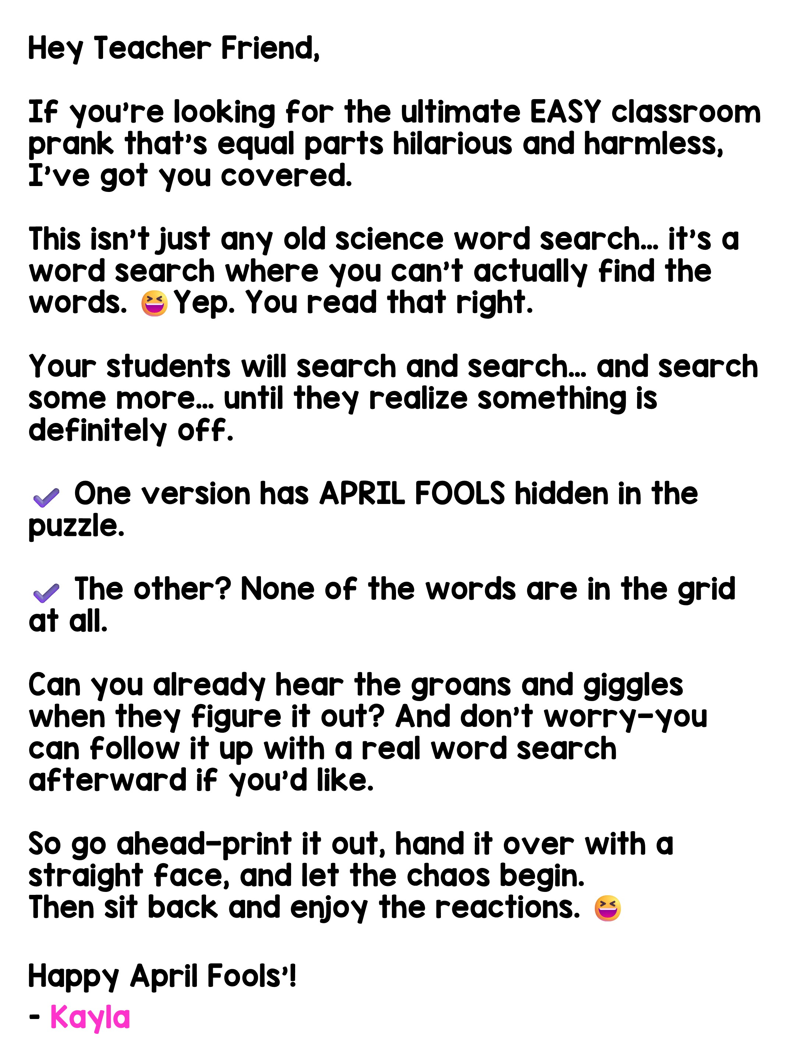

Slide 2


Slide 3
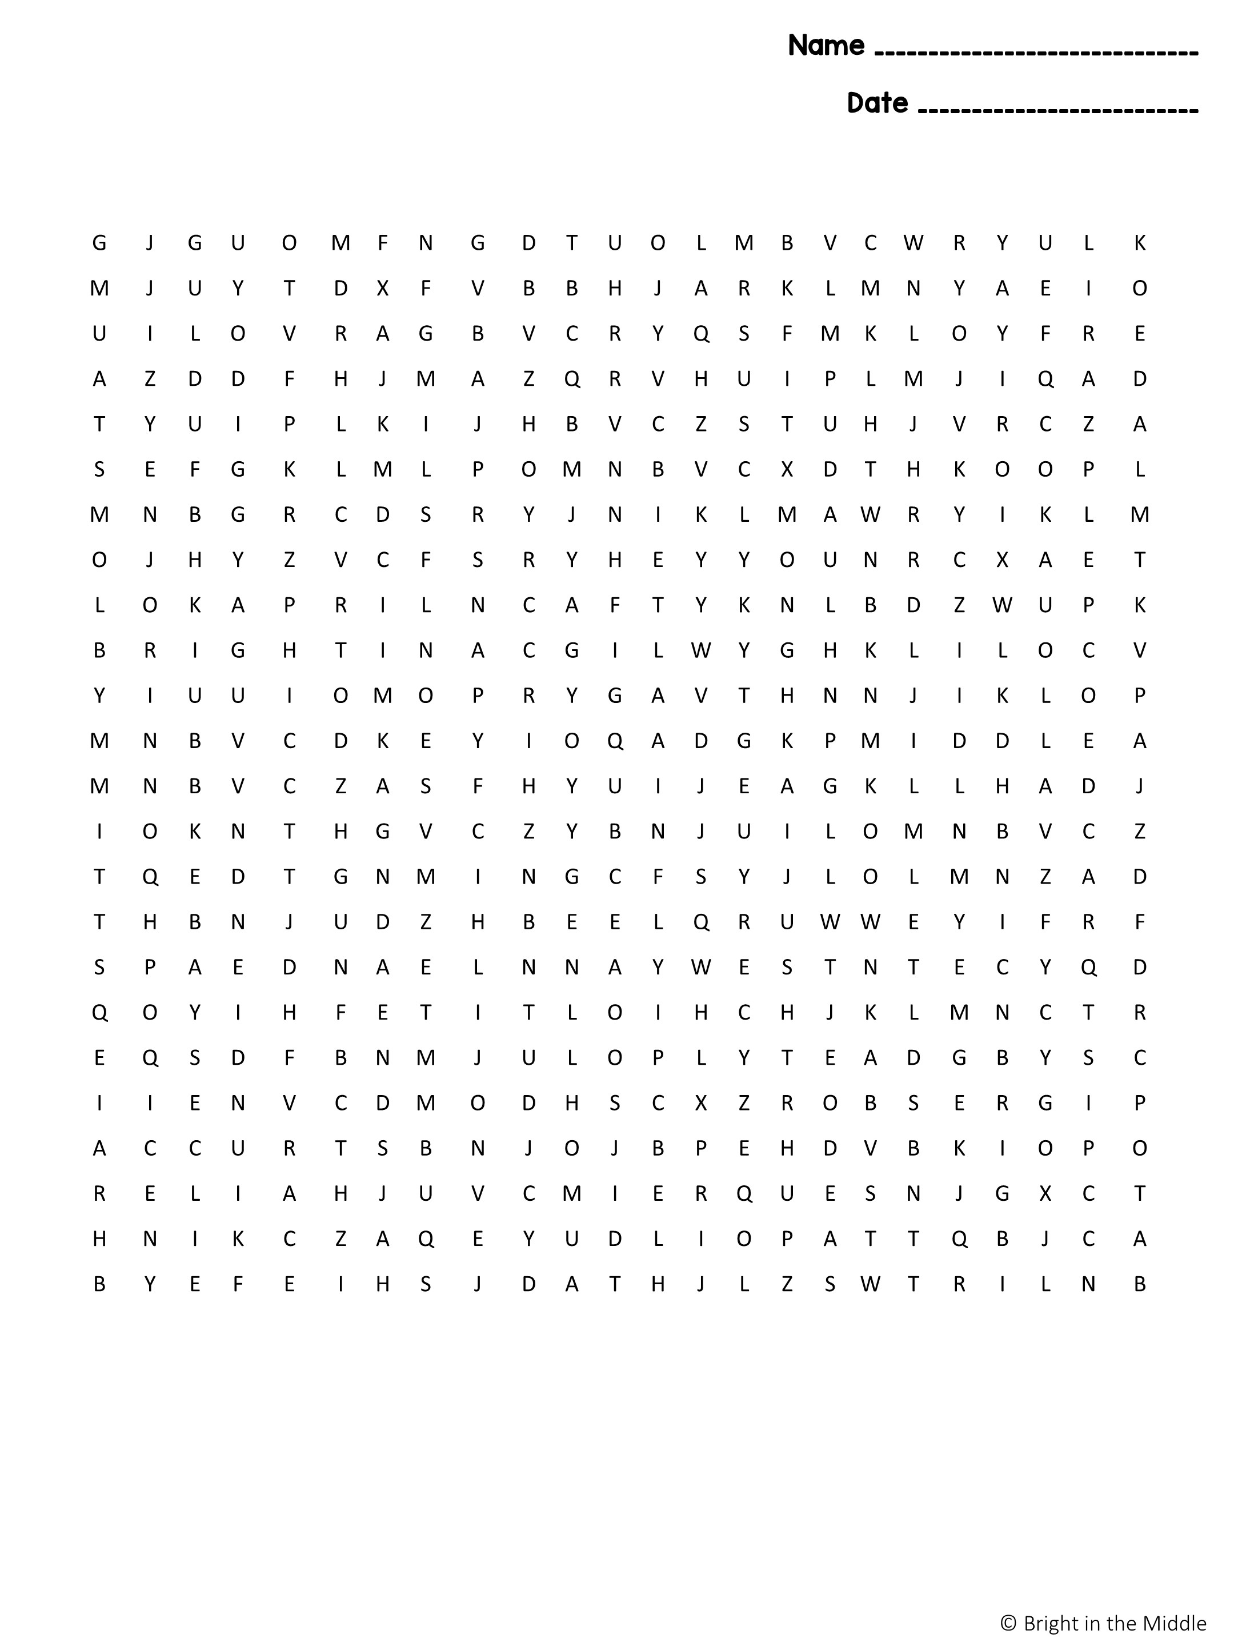
I LOVE SCIENCE
ACCURACY
ANALYSIS
BIAS
CLAIM
CONCLUSION
CONSTANTS
CONTROL GROUP
DATA
DEPENDENT VARIABLE
EVIDENCE
EXPERIMENT
HYPOTHESIS
INDEPENDENT VARIABLE
INFERENCE
INVESTIGATION
JUSTIFICATION
MEASUREMENT
MODEL
OBSERVATION
PATTERN
PEER REVIEW
PREDICTION
PRECISION
QUESTION
REASONING
RELIABILITY
REPETITION
RESULTS
SCIENTIFIC METHOD
SIMULATION
TREND
TRIAL

Slide 4


Slide 5

I LOVE SCIENCE
ACCURACY
ANALYSIS
BIAS
CLAIM
CONCLUSION
CONSTANTS
CONTROL GROUP
DATA
DEPENDENT VARIABLE
EVIDENCE
EXPERIMENT
HYPOTHESIS
INDEPENDENT VARIABLE
INFERENCE
INVESTIGATION
JUSTIFICATION
MEASUREMENT
MODEL
OBSERVATION
PATTERN
PEER REVIEW
PREDICTION
PRECISION
QUESTION
REASONING
RELIABILITY
REPETITION
RESULTS
SCIENTIFIC METHOD
SIMULATION
TREND
TRIAL

Slide 6
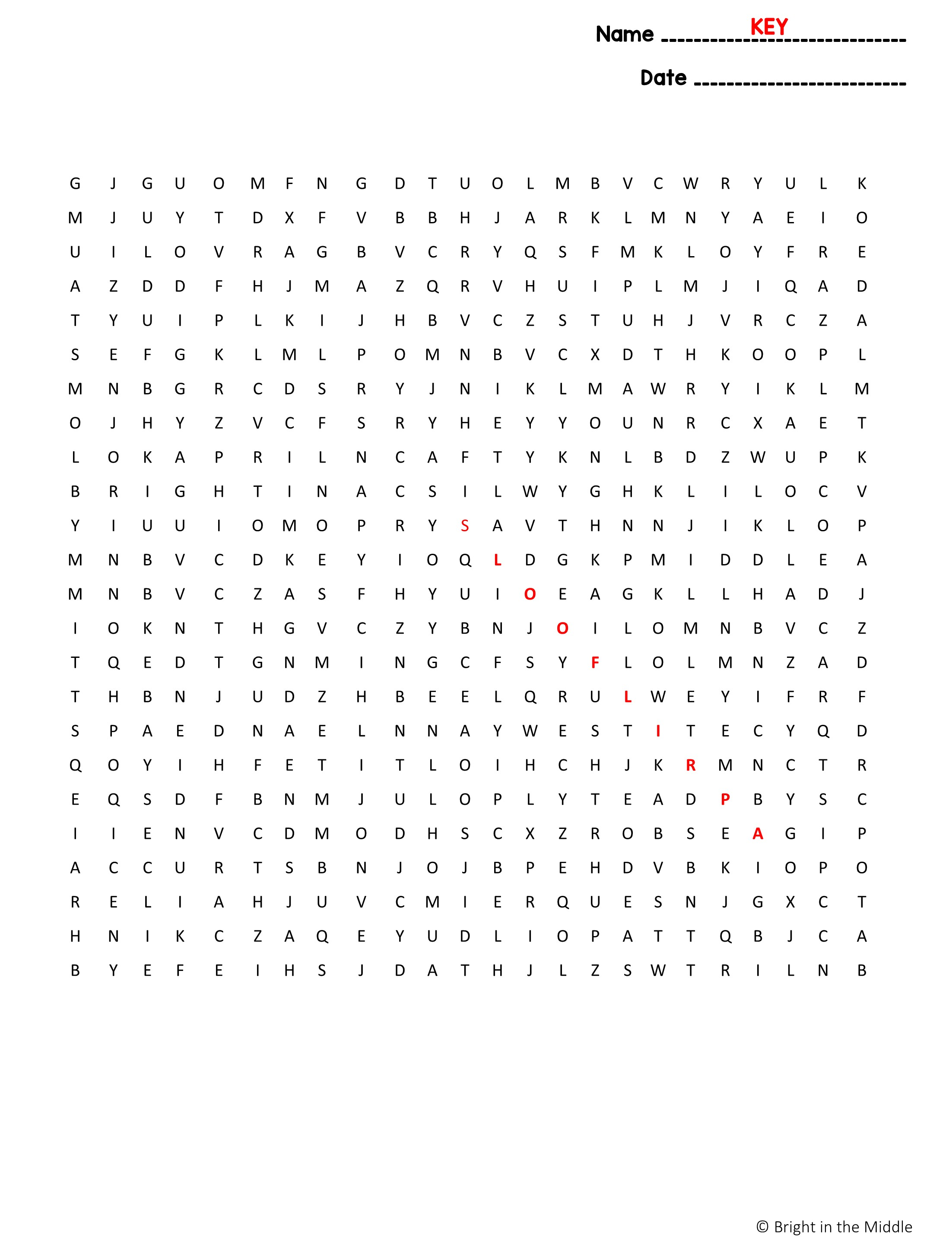
I LOVE SCIENCE
ACCURACY
ANALYSIS
BIAS
CLAIM
CONCLUSION
CONSTANTS
CONTROL GROUP
DATA
DEPENDENT VARIABLE
EVIDENCE
EXPERIMENT
HYPOTHESIS
INDEPENDENT VARIABLE
INFERENCE
INVESTIGATION
JUSTIFICATION
MEASUREMENT
MODEL
OBSERVATION
PATTERN
PEER REVIEW
PREDICTION
PRECISION
QUESTION
REASONING
RELIABILITY
REPETITION
RESULTS
SCIENTIFIC METHOD
SIMULATION
TREND
TRIAL

